Slide 1


Quantum Coin Flipping where weakness is a virtue
Joint work with Jérémie Roland (supervisor), Stephan Weis and Chrysoula Vlachou Atul Singh Arora
Notes:
Bonsoir! Je remercie tout le monde dans cet auditoire et ceux qui nous ont rejoints en ligne. Je suis ravi de vous voir tous.
Good evening! I thank everyone in this auditorium and those who’ve joined us online. I am elated to see you all.
Aujourd'hui, vous avez, pour des raisons mystérieuses, accepté de me laisser présenter les résultats que j'ai obtenus dans mes recherches, au cours des quatre dernières années.
Today, you have for mysterious reasons, agreed to let me showcase the results I have obtained in my research, over the past four years.
Celles-ci n'auraient pas été possibles sans les contributions ingénieuses de Stephan Weis, Chrysoula Vlachou (connue par beaucoup sous le nom de Cryogenics) et Jérémie Roland (qui a placé la barre très haut sur ce que le mot "patron" devait signifier).
These would not have been possible without the ingenious contributions of Stephan Weis, Chrysoula Vlachou (known to many as Cryogenics), and Jérémie Roland (who has set an unachievable bar for what the word “boss” ought to mean).
Le titre de ma thèse est «Quantum Weak Coin Flipping, where weakness is a virtue». À la fin des quatre premières slides, sa signification devrait déjà être claire.
The title of my thesis is “Quantum Weak Coin Flipping, where weakness is a virtue”. By the end of the first four slides, its meaning I hope is already clear.

Slide 2
PhD Thesis in 4 Slides
Notes:
Le plan est de donner progressivement des descriptions plus approfondies de mon travail. Je vais commencer par un résumé de 4 slides.
The plan is to give progressively deeper descriptions of my work. I’ll start with a 4-slide summary.
Notez que cette partie et la suivante s'adressent à un public général. Je vous encourage à poser toutes vos questions sans aucune hésitation. En fait, pour vous encourager davantage, j'ai une boîte de chocolats. Chaque question vous fait gagner un chocolat, à condition bien sûr que je n'en manque pas.
Note that this and the following part are targeted at a general audience. I encourage you to ask all your questions without any hesitation. In fact, to further encourage you, I have a box of chocolates. Every question wins you a chocolate, granted of course I haven’t run out of them.

Slide 3
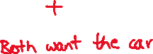


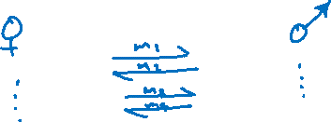

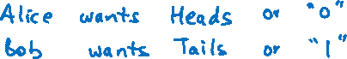
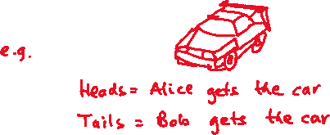
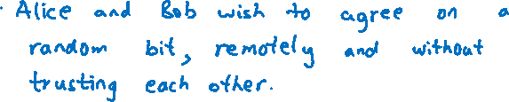
Notes:
Imaginez qu'Alice est à Bruxelles, Bob est à Delhi et que les déplacements sont désormais limités.
Imagine Alice is in Brussels, Bob is in Delhi and now travel has been restricted.
Pour une raison quelconque, ils veulent «lancer une pièce» en échangeant des messages.
For some reason, they want to “flip a coin” by exchanging messages.
Autrement dit, une fois qu'ils ont échangé leurs messages, ils doivent tous les deux être convaincus que le résultat est «Face», par exemple.
That is, once they have exchanged their messages, they both should be convinced that the outcome is “Heads”, for example.
Bob dit: «C'est facile; Je vais lancer une pièce et te dire la réponse. » Alice, apparemment convaincue au début, crie au scandale. "C'est pratique, n'est-ce pas?. Comment savoir que tu ne me mens pas?», Rétorque-t-elle.
Bob says, “This is easy; I’ll flip a coin and tell you the answer.” Alice, seemingly convinced at first, cries foul. “That is convenient isn’t it? How do I know you’re not lying?”, she retorts.
En pratique, supposons que «Face» signifie qu'Alice puisse garder un objet contesté, comme une voiture de luxe /luks/. La question de décider «qui gardera la voiture» ou de manière générale de «se mettre d’accord sur un bit aléatoire sans faire confiance à l'autre joueur» s'appelle le Coin Flipping.
For concreteness, let us suppose that “Heads” means Alice gets to keep a disputed object, such as a fancy car. The problem of deciding “who gets to keep the car” or more generally “agreeing on a random bit without trusting the other player” is called Coin Flipping.
Des questions à ce stade?
Any questions at this point?
Il n'est pas difficile d'imaginer qu'Alice et Bob veulent tous les deux la voiture, donc si Alice triche, elle essaiera de convaincre Bob que le résultat est Face - c'est-à-dire qu’Alice a gagné. De même, si Bob triche, il essaiera de convaincre Alice que le résultat est Pile, c'est-à-dire que Bob a gagné.
It is not hard to imagine that both Alice and Bob want the car, so if Alice cheats, she will try to convince Bob that the outcome is Heads—i.e. Alice won. Analogously, if Bob cheats, he’ll try to convince Alice that the outcome is Tails—i.e. Bob won.
Si nous faisons cette hypothèse supplémentaire, alors le problème est appelé Weak Coin Flipping.
If we do make this extra assumption, then the problem is termed Weak Coin Flipping.
Pourquoi est-ce une hypothèse? Eh bien, il est concevable que Bob ait décidé de renoncer complètement aux véhicules à essence, mais Alice ne le sait pas. Elle ne veut pas donner de satisfaction à Bob de toute façon.
Why is that an assumption? Well, it is conceivable that Bob has decided to forego petrol burning vehicles altogether, but Alice is unaware of this. She doesn’t want to give Bob the satisfaction either ways.

Slide 4
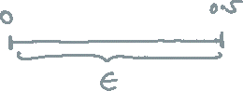
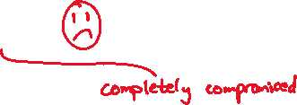


Notes:
Maintenant que nous avons défini le problème du Coin Flipping comme étant deux personnes qui échangent des messages pour s'entendre sur un pile ou face au hasard, nous pouvons aller plus loin.
Now that we have defined the coin flipping problem as two people who exchange messages to agree on a heads or tails at random, we can proceed further.
Un schéma /shema/ qui indique à Alice et Bob comment échanger des messages pour résoudre le problème du Coin Flipping s'appelle un protocole Coin Flipping.
A scheme that tells Alice and Bob how to exchange messages to solve the coin flipping problem is called a Coin Flipping protocol.
Mais évidemment, différents protocoles offriront différents niveaux de sécurité. Rappelez-vous le protocole proposé par Bob où il lance une pièce et déclare le résultat? C'était un mauvais protocole.
But obviously, different protocols will offer different levels of security. Remember the protocol proposed by Bob where he flips a coin and declares the outcome? That was a bad protocol.
Le facteur de mérite d'un protocole Coin Flipping est donnée par un nombre ε qui est connu comme le biais du protocole.
The figure of merit of a Coin Flipping protocol, is given by a number ε which is known as the bias of the protocol.
Il capture à quel point une personne qui triche peut biaiser le résultat vers la valeur souhaitée. Ainsi, un zéro signifie que le protocole est sécurisé et un demi signifie qu'il est complètement non sécurisé. Pourquoi un demi, nous verrons plus tard.
It captures how much a cheating person can bias the outcome towards their desired value. So a zero means the protocol is secure and a half means it is completely insecure. Why half, we’ll see later.

Slide 5
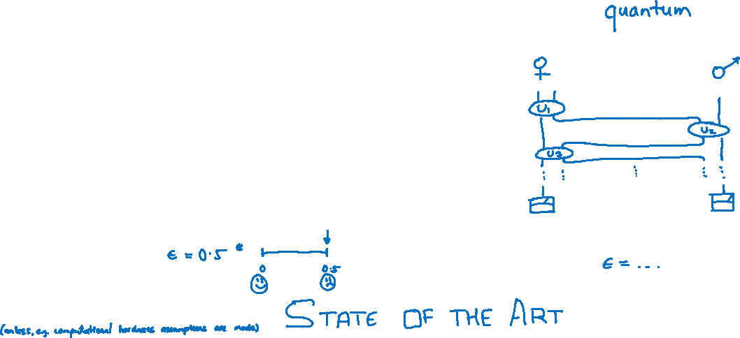
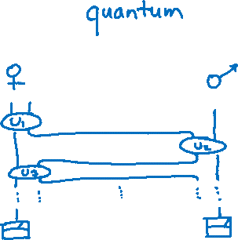
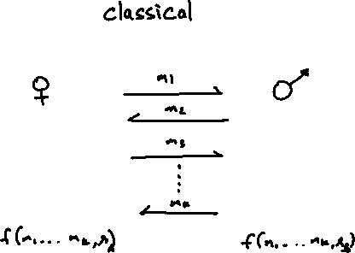

Notes:
Considérons tout protocole où des messages "classiques" sont échangés, c'est-à-dire que les messages n'utilisent pas de quantique, pour mettre en œuvre le coin flipping.
Consider any protocol where “classical” messages are exchanged, i.e. the messages don’t use any quantum, to implement coin flipping.
Il a été démontré que tous ces protocoles doivent être totalement non sécurisé, c'est-à-dire avoir un biais de moitié. Cela est vrai aussi bien pour les strong et weak coin flipping.
It has been shown that all of these must be completely insecure, i.e. have a bias of half. This is true of both strong and weak coin flipping.
Mais que se passe-t-il si les messages sont quantiques ? Je vais expliquer en détail ce que signifie un message quantique ; pour l'instant, considérez-les comme des messages qui exploitent certaines propriétés exotiques des atomes et des photons. Dans ce cas, le biais a une histoire plus intéressante.
But what happens if the messages are quantum? I will explain in detail what a quantum message means; for now, think of them as messages that harness some exotic properties exhibited by atoms and photons. In this case, the bias has a more interesting story.

Slide 6
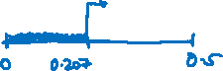



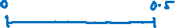
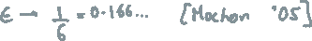
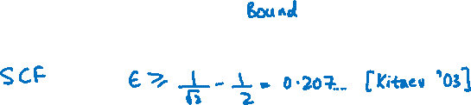
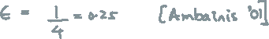
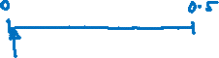

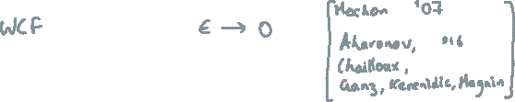
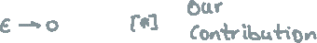

Notes:
Pour un Strong Coin Flipping, un génie russe, Alexei Kitaev, a prouvé que le biais doit être borné inférieurement par un nombre fixe, qui est d'environ 0,207 (zero virgule, deux cent sept). Cela signifie qu'il est impossible de faire du strong coin flipping parfaitement (ou même presque parfaitement). Le meilleur protocole explicite connu, en revanche, a un biais de ¼ (un quart/car).
For strong coin flipping, a genius hailing from Russia, called Alexei Kitaev, proved that the bias must be lower-bounded by a fixed number, which is approx. 0.207. This means that perfect (or even near-perfect) strong coin flipping is impossible. The best-known explicit protocol, on the other hand, has a bias of ¼.
En ce qui concerne le weak coin flipping Mochon a annoncé un résultat révolutionnaire en 2007 en s'appuyant sur les travaux de Kitaev. Il a montré qu'il existe bel et bien des protocoles de weak coin flipping avec un biais qui disparaît. La flèche, à côté de epsilon, indique que le biais peut approcher de zéro autant qu’on le souhaite. Cependant, sa preuve n'est pas constructive [Ask: Jérémie]. Cela signifie que Mochon savait qu'un protocole existait, mais qu'il ne savait tout simplement pas de quoi il s'agissait.
As for weak coin flipping, by building upon the work of Kitaev, Mochon announced a breakthrough result in 2007. He showed that weak coin flipping protocols with vanishing bias really do exist. The arrow, next to epsilon, indicates that the bias can be made as close to zero as one wishes. However, his proof was non-constructive. This means that Mochon knew a protocol existed, but he just didn’t know what it is.
Le meilleur protocole explicite connu pour le weak coin flipping a un biais de 1/6 (un sixième), également dû à Mochon.
The best-known explicit protocol for weak coin flipping, has a bias of 1/6, also due to Mochon.
Fun fact, after his breakthrough result, he left academia. And this has happened to two other researchers who made significant contributions to the subject. I hope this trend doesn’t posses any predictive power over the fate of current researchers. Yes, my standards for the word fun aren’t quite as high. Coin flipping can do this to you.
Donc, comme vous l'avez peut-être deviné, notre contribution a consisté à combler cette lacune - nous avons élaboré des protocoles de weak coin flipping qui approchent le biais zéro. Ceci complète mon aperçu en 4 slides de nos contributions à ce sujet, au cours des quatre dernières années.
So, as you might have guessed, our contribution was to close this gap—we constructed weak coin flipping protocols that approach zero bias. This completes my 4-slide overview of our contributions to this subject, over the last four years.

Slide 7
Illustrated Background
Quantum Mechanics, Computer Science, Cryptography
Notes:
I hope everything so far has been clear. I am happy to answer any questions you might have at this stage.
In this section, I intend to give you a rather visual and conceptual introduction to quantum mechanics.
Many insights can be conveyed without using any equations which is precisely what I have tried doing.
I will also tell you how this relates to the exciting fields of computer science and cryptography by discussing simple and intuitive examples.
In the interest of time, henceforth I’ll restrict myself to English only.
I must, however, thank Zac and Célia for their assiduous support with the French translation.

Slide 8
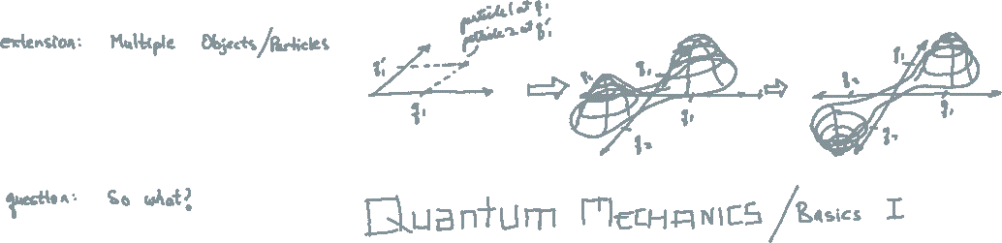

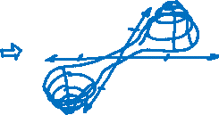


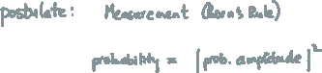
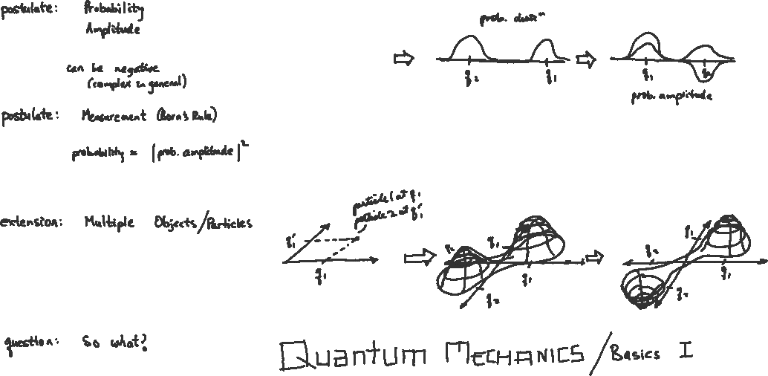
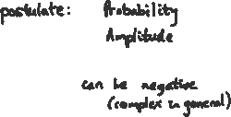
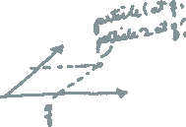
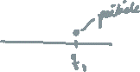
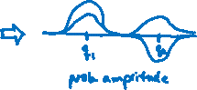
Notes:
We start with a very basic concept, the location of a particle.
Suppose we know that a particle is sitting at some location.
How might we represent this knowledge?
Well, we could measure the distance of this point from some fixed point and represent it by q_1, as shown in this graph.
For simplicity, I assume the particle can only be moved along this line.
What if we did not know the location of the particle with certainty?
Suppose we knew it could either be around the point q_1 or around the point q_2.
How might we represent this knowledge?
We could draw a probability distribution as shown. Higher the likelihood, taller the peak.
So far, everything I have said, is how the world was thought to fundamentally behave—at least as far as particles are concerned.
That is, until the 1920s.
At this point, numerous ingenious experiments were painstakingly performed, and bold new ideas were proposed.
Most physicists conceded that nature was telling them that even their basic understanding of particles was flawed.
The probabilities had to be replaced by what they called “probability amplitudes”.
Probability amplitudes have two important properties.
First, they can be negative (in fact they can even be complex numbers, for the experts cringing in their seats).
Second, squaring it, yields the probability.
This is indicated by the final figure. These may be seen as the first two postulates of quantum mechanics.
Any questions at this point?
Let us now extend this understanding to two particles.
I repeat the same exercise, but with two particles this time.
Suppose we know that the first particle is sitting at the location q and the second one is sitting at the location p.
I can represent this using a single point in the 2d plane as shown.
The 1st axis encodes the position of the first particle, q and the 2nd axis encodes the position of the second particle, p.
Let’s now switch to the probabilistic case.
Suppose I know that the positions of the particles are correlated,
i.e. either they are situated at location (q,p) or they are situated at location (-q,-p).
This can be represented by two peaks, centred at (q,p) and (-q,-p).
And now for the quantum case, for instance, the hill centred at (q,p) stays positive while the hill centred at (-q,-p) becomes a valley.
The question is, why do you care?

Slide 9
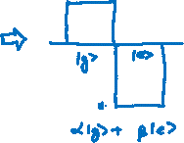

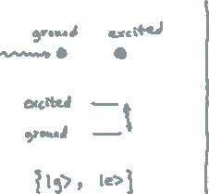
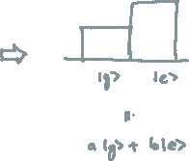

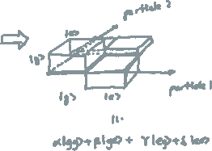
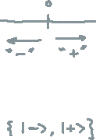

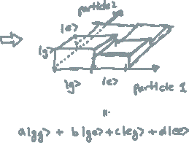
Notes:
Well, to address that, we need to simplify things a little.
A particle’s position is a continuous property, i.e. roughly speaking, it can take any value.
This makes the description more cumbersome for our purpose here.
Thus, we focus on discrete properties of particles.
These can be spin, polarisation, energy level, mode etc.
but don’t worry if none of these sound too familiar.
We can even “discretise” position.
We can say that a particle on the right side of some reference location will be called + and the one on the left will be called -.
Energy levels are also easy to understand.
An atom’s usual state is termed the “ground state”.
If we shine a laser on it, for example, it can absorb that energy and jump to an excited state.
These levels are discrete.
Quantum mechanics’ ability to explain this was one of its key triumphs.
We represent the ground state as g and the excited state as e.
Those strange symbols were an invention of a famous physicist, Paul Dirac.
For us, they simply refer to the “state” of the system we are describing, viz. that of the particle.
Questions?
We play the same game.
We start with a single particle, or for concreteness, a single atom.
If we know it is precisely in its ground state, we represent it using the state g.
If we know that it is in the state g with probability a and state e with probability b, we may represent it using the graph.
We may even write it as a “probability vector”.
Finally, in the quantum case, we must use probability amplitudes.
These can be negative.
We represent this using the graph.
The associated state of the system can be expressed as alpha g plus beta e.
Now, suppose we have two atoms, both in the ground state. We represent that using the state gg.
If we knew some probability distribution over the states of these atoms,
for example, we knew that the probability of both being in the ground state is the highest,
the graph could look something like this.
The state is now represented using a probability vector a gg + b ge + c eg + d ee.
Here b for example encodes the probability of the first atom being in the ground state and the second being in the excited state.
Finally, for the quantum case, the probability amplitude can be negative.
We represent this using the graph as shown.
The state is similarly written except that α, β, γ, and δ can now be negative.
Does it make sense?
I still haven’t told you why this is relevant.

Slide 10

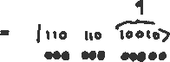
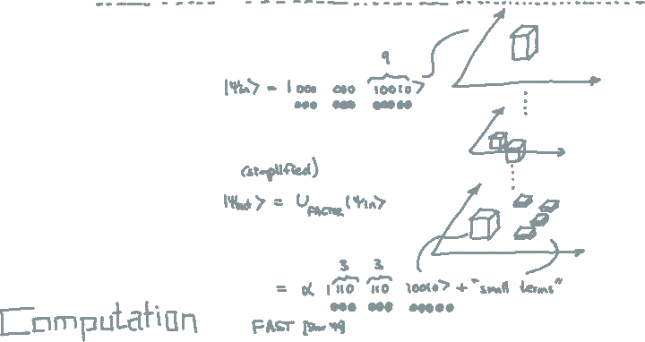

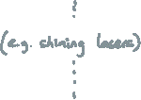


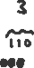

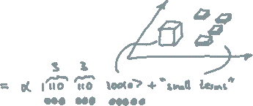
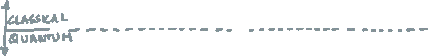
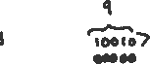
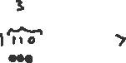
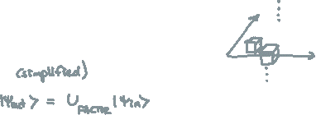
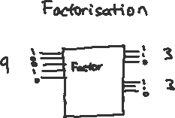

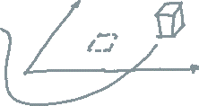
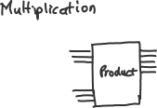
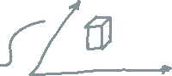
Notes:
But we can now finally see how these strange laws of nature can be put to use.
Let’s start with the problem of multiplication.
I use this example to contrast the functioning of a regular computer, such as your phone,
with how a quantum computer might work.
You must have heard that computers, internally store all the information as a string of zeros and ones.
Suppose we want our computer to multiply the numbers 3 and 3.
This we represent as a circuit which takes as input 110 and 110,
these are the strings of zeros and ones which encode 3 and 3.
The output is 10010, which corresponds to 9.
Now this operation can be performed very quickly.
We can make this notion of “fast” more precise, but the intuitive understanding suffices at this point.
How might a quantum computer perform this computation?
We store the first input, the number 3 as 110 using three atoms—excited excited and ground.
Similarly, the next input, again the number 3 in our example, is stored as three atoms, excited, excited and ground.
Finally, we keep five atoms in the ground state to hold the result.
Recall how when we considered one atom, we had a one-dimensional graph and when we considered two atoms, we had a two-dimensional graph.
Now we have eleven atoms, so the graph should really be eleven-dimensional.
But for illustration, I pretend that this two-dimensional graph represents the eleven-dimensional graph corresponding to the eleven atoms.
To perform the computation, this probability weight needs to be moved to the state which corresponds to the answer.
This may be done by means of specific physical interactions with the atoms such as shining lasers.
The end result must be that almost all the weight is on the state where the atoms that encode the inputs are unchanged and the atoms that encode the answer are excited, ground, ground, excited and ground,
i.e. in the state 10010 which corresponds to the number 9.
This operation is also performed quickly by a quantum computer.
Thus far, the quantum computer doesn’t seem to offer any advantage. So let me remedy that.
Consider the opposite problem, i.e. suppose that a number is given, say 9, and
we are required to find its factors, that is numbers whose product yields 9.
We can again represent this as a circuit that takes 10010 as input,
the string of zeros and ones for 9 and outputs 110 and 110,
the string for 3 and 3, respectively.
Mathematicians have struggled with this problem for over 2 millennia and yet, we do not know of any fast algorithm for solving this problem.
You already know where I’m going with this. What happens quantumly?
Well, we store the input again into atoms as depicted.
Peter Schor, a researcher at MIT, found a fast algorithm that can shift a significant part of the weight from this input state, onto the state corresponding to the answer,
that is, to 3 and 3, while leaving the input 9 unchanged.
The key insight he used was that the weights can be positive and negative during the computation.
He used clever techniques for moving these weights so that they cancel everywhere but accumulate at the right answer.
As before, physically, this algorithm is implemented by means of interaction with the atoms, using lasers for instance.
So there you have it; quantum mechanics in action, quickly solving an ancient problem that a classical computer struggles to solve, despite our best efforts.
Questions?
If not, we can move on to the part, cryptography.

Slide 11
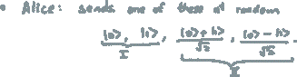
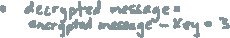
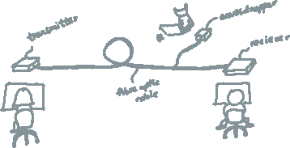
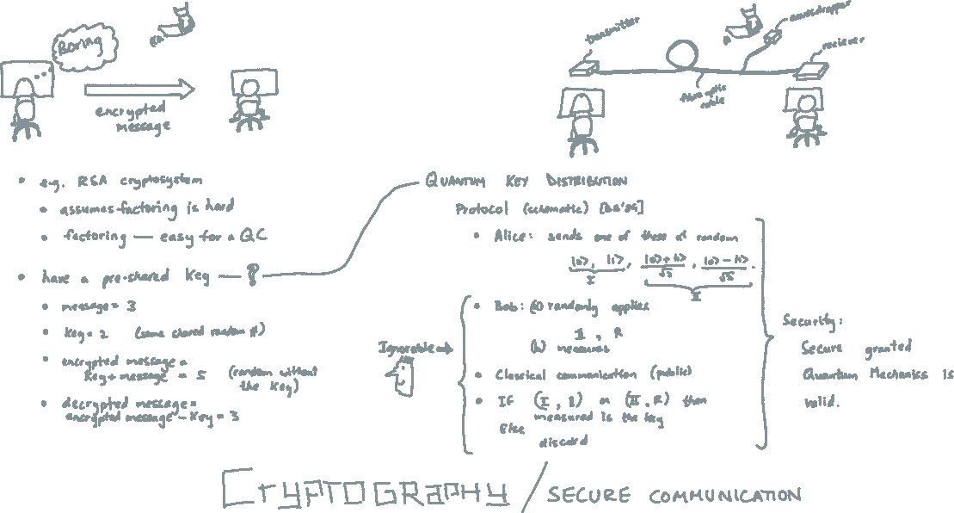
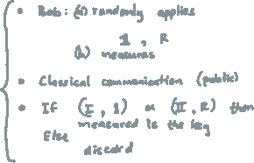




Notes:
One of the most basic tasks one considers in the study of Cryptography is the ability of exchanging secret messages.
Suppose Alice wants to tell Bob that she is getting bored, but she doesn’t want anyone else, such as the speaker, to learn this.
She could, for example, send a message over the internet.
It is likely that this action, behind the scenes, uses what is known as the RSA cryptosystem.
The name is not too important but what is important is that this system relies on
the assumption that factoring is a hard problem.
But we just saw that a quantum computer can factor numbers easily!
Yes, this means that a quantum computer can break the security of some of the cryptosystems we are using, even today.
The catch is that building quantum computers that are powerful enough to pose any real threat has proven to be notoriously challenging.
There is an older, more inconvenient albeit safer method of exchanging secret messages.
It posits that if Alice and Bob meet and agree on a random key, then they can securely communicate afterwards using this key.
This is not very hard to see.
Suppose the message Alice wants to send is 3 and
the key they agreed to was 2.
The eavesdropper knows neither the message nor the key at this point.
Alice encrypts her message by adding it to the key, i.e. she adds 3 and 2 to obtain 5.
She sends this number to Bob.
Now, even if the eavesdropper learns this number 5, he can’t extract the message from it because he doesn’t have the key.
Bob, on the other hand, can easily decrypt by subtracting the key from the encrypted message, i.e. 5 – 3 to obtain 2, the message Alice had sent.
The problem, of course, is that meeting physically is inconvenient. This problem was solved by RSA but we saw that quantum computers render it insecure.
The solution, as you might have guessed, again comes from Quantum mechanics.
In the year 1984, Bennett and Brassard proposed a Quantum Key Distribution protocol which solves precisely this problem of key distribution, without Alice and Bob having to physically meet.
The protocol involves the sending of a photon by Alice.
We now use photons instead of atoms because photons are better suited to communication tasks;
they both posses the relevant quantum properties.
This photon is in one of the four states described.
By now, I hope at least the notation makes sense.
Bob performs certain operations on this incoming photon and measures it.
The details are not too important here.
What is relevant is that this protocol was shown to be secure, granted the laws of quantum mechanics are valid.
No further assumptions are needed.
Contrast this to the RSA scheme which relied on the hardness of factoring numbers.
This was the famous contribution of quantum mechanics to the field of cryptography.
Any questions at this point?

Slide 12





Notes:
Cryptography today is a rich field and has many branches.
We briefly saw the branch of secure communication where Alice and Bob wish to protect their communication from an eavesdropper.
There is another branch, called secure two-party computation.
Here, Alice is given an input an x and Bob is given an input y.
They wish to evaluate a function of both their inputs, but they don’t want the other party to learn their input,
i.e. Alice shouldn’t learn y and Bob shouldn’t learn x.
Consider a realistic example.
Suppose there are two investment banks and they want to ensure that their risks are non-overlapping.
Since these banks compete, they don’t want the other bank to learn anything about their investments.
Obviously, they wouldn’t want a third party to mediate this process either.
A simpler, less realistic example, is called the millionaire problem.
Two millionaires want to ascertain who is richer but neither wants the other to learn exactly how much money they possess.

Slide 13











Slide 14
Prior Art
Notes:
I hope I have been able to explain what quantum mechanics is, how it relates to computer science and cryptography and finally, how my research problem fits into this larger context.
The following sections might get slightly technical and are targeted at a scientific audience. Regardless, if something is unclear, please don’t hesitate to ask.

Slide 15
Situations
Honest player: A player that follows the protocol exactly as described.
Alice | Bob | Feature
Honest | Honest | Correctness
Cheats | Honest | Alice can bias
Honest | Cheats | Bob can bias
Cheats | Cheats | Independent of the protocol
Bias of a protocol: A protocol that solves the CF problem has bias ϵ if neither player can force their desired outcome with probability more than ½ + ϵ.
Notes:
To understand coin flipping better, we begin with exploring the different situations which can arise when we try to analyse its security.

Slide 16







Situations | Weak CF
NB. For WCF the players have opposite preferred outcomes.
Alice | Bob | Pr(A wins) | Pr(B wins)
Honest | Honest
Cheats | Honest
Honest | Cheats
Bias:
NB.

Slide 17






Situations | Weak CF | Flip and declare
Protocol: Alice flips a coin and declares the outcome to Bob.
Alice | Bob | Pr(A wins) | Pr(B wins)
Honest | Honest
Cheats | Honest
Honest | Cheats
Bias:

Slide 18




Kitaev | Three Equivalent Formalisms

Slide 19


Kitaev | Protocol

Slide 20



Kitaev | TDPG

Slide 21





Kitaev’s Framework #2 | TDPG | Rule

Slide 22





Kitaev’s Frameworks | TDPG | Rule

Slide 23
Kitaev’s Frameworks | TDPG | Example

Slide 24

Kitaev’s Frameworks | TDPG | Example

Slide 25

Kitaev’s Frameworks | TDPG | Example

Slide 26

Kitaev’s Frameworks | TIPG

Slide 27



Mochon | Near-perfect WCF is possible

Slide 28
Contributions
A framework—TEF, An analytic solution, A numerical algorithm—Elliptic-Monotone-Align Algorithm)

Slide 29


Slide 30



Contributions
Notes:
TODO: fix the order

Slide 31



Contributions

Slide 32





TEF
Notes:
This step can be understood as follows.
Suppose we are given a point game.
Let us focus on two consecutive frames thereof.
This corresponds to applying some standard unitaries and a U_non-trivial which depends on the coordinates and probabilities of the points involved.
More precisely, if a unitary U which satisfies the constraints specified in the blue box can be found, then the corresponding step of the point game can be converted into an explicit protocol.
The v encodes the weights of the initial point, X_g encodes the coordinates of the initial points. W and X_h do the same for the final set of points.
If we can find such a U for each step of Mochon’s point game, then we can essentially construct protocols with vanishing bias.

Slide 33

TEF

Slide 34

TEF | Blinkered Unitaries

Slide 35

Analytic Solution | Algebraic
Notes:
TODO: animation stopping

Slide 36


Analytic Solution | Algebraic
Significance: yields protocols with vanishing bias.
Limitation: a priori, only works for Mochon’s games.

Slide 37


Elliptic Monotone Align (EMA) Algorithm
TEF

Slide 38

EMA | Elliptic Representation

Slide 39







EMA | Elliptic Representation

Slide 40




EMA | Elliptic Representation

Slide 41



EMA | Elliptic Monotone-Align Algorithm
TEF

Slide 42
Conclusion

Slide 43
Conclusion

Slide 44
Outlook

Slide 45


Notes:
I thank you for your attention. We encourage you to look at our article on the arXiv and the talk on YouTube. I look forward to your questions.

Slide 46

Notes:
I thank you for your attention. We encourage you to look at our article on the arXiv and the talk on YouTube. I look forward to your questions.

Slide 47

?
Notes:
Replace this with a smiley or a sketch of ULB or some such.

Slide 48

Thank you
arXiv:1811.02984
The work was funded by FRIA, FNRS; FNRS grant QUICTIME; FNRS grant QuantAlgo.

Slide 49


Resource Requirements

Slide 50






EMA | Big Picture

Slide 51




EMA | Big Picture (cont.)

Slide 52



EMA | EBRM=EBM

Slide 53


Slide 54


Slide 55


Slide 56


